Slide 1
Chapter 9
Campaigns, Elections, and Voting
American Democracy Now, 7th edition
Brigid Callahan Harrison
Jean Wahl Harris
Michelle D. Deardorff
Copyright 2022 © McGraw Hill LLC. All rights reserved. No reproduction or distribution without the prior written consent of McGraw Hill LLC.

Slide 2
The Importance of Fair, Independent Elections
In 2017, a jointly issued report stated that with “high confidence” that the Russian government had conducted a sophisticated campaign to influence the 2016 presidential election.
Both Facebook and Twitter identified related posts.
Twitter posts alone reached more than 677,775 Americans before the election.

Slide 3
Why Election Meddling Matters
Of utmost importance is the issue of national sovereignty—that nations have the right of self-rule without interference from outside.
Concept of popular sovereignty means that governments are created with the consent of the governed.

Slide 4
Intentional Efforts at Voter Suppression
In 2020, complaints emerged that in some states, efforts were being made to suppress voter turnout in the wake of the COVID-19 pandemic, which altered how elections could and should take place.

Slide 5
Political Participation as an Expression of the Will of the People
Campaigns, elections, and voting are fundamental aspects of the civil engagement of Americans.
Civic participation is essential; and among its most important forms is electoral political participation.

Slide 6
The Act of Voting
Process of voting begins when a voter registers to vote.
Voting registration requirements vary greatly from state to state.
In the United States, voters use an Australian ballot, a secret ballot prepared by the government, distributed to all eligible voters, and, when balloting is completed, counted by government officials in an unbiased fashion, without corruption or regard to individual preferences.

Slide 7
The 2000 Election and Its Impact
In the 2000 presidential election between Democrat Al Gore and Republican George W. Bush, enormous controversy erupted over the voting in Florida.
In the end, the U.S. Supreme Court had the final say.
Changes were made in federal policy regarding the conduct of elections by the states.
Key revision came through passage of the Help America Vote Act of 2002 (HAVA).
HAVA allocated $650 million to assist states in changing from punch card ballots to electronic voting systems and set a deadline of 2005 for states to comply.

Slide 8
Types of Ballots
Party-column ballot organizes the candidates by party, so that all of a given party’s candidates for every office are arranged in one column.
Increases voters’ tendency to vote the “party line” and increases the coattail effect whereby down-ballot candidates benefit from the popularity of the top-of-the-ticket nominee.
Office-block ballot arranges all candidates for a particular office under the name of that office.
These ballots are more likely to encourage ticket splitting—dividing votes between candidates from different parties.

Slide 9
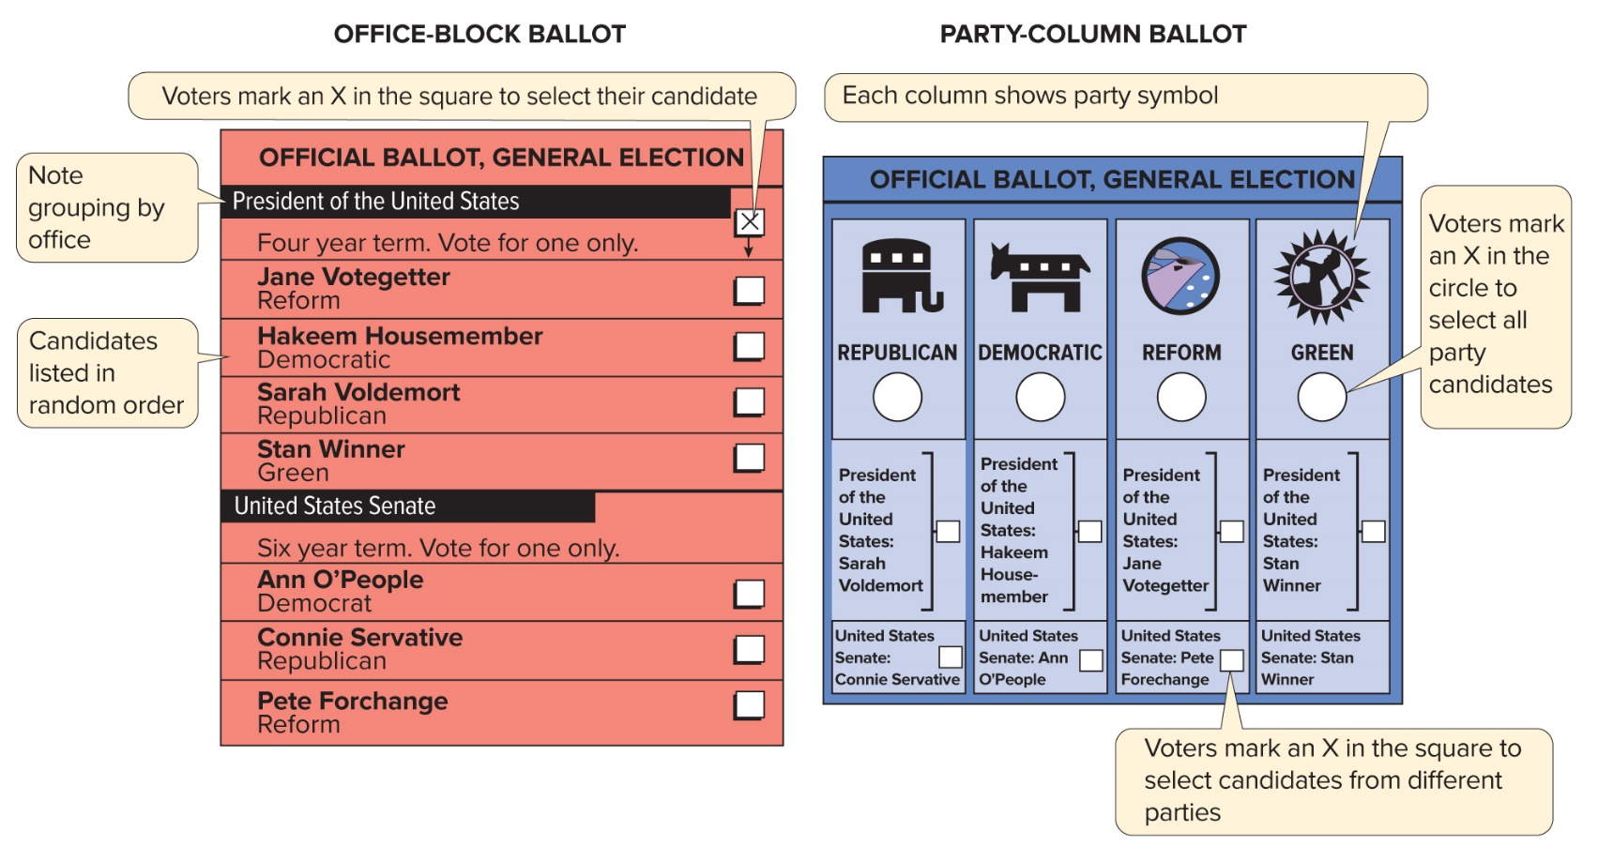
Figure 9.1 Office Group and Party Column Ballots
Access the text alternative for slide images.

Slide 10
Voting by Mail
Traditionally, absentee voting, in which voters cast their ballots in advance by mail, was allowed only when disability, illness, school, work, service in the armed forces, or travel prevented voters from casting a ballot in their voting precincts.
Increasingly, many states accept mail-in ballot applications simply for the convenience of the voter.
In Oregon, Washington, Colorado, and parts of Utah and California, all voters are now sent mail ballots automatically.

Slide 11
Running for Office: The Choice to Run
Several types of motivation are generally in play when a person decides to declare a candidacy.
Sense of civic responsibility.
Sense of party loyalty.
Interest in increasing the candidate’s name recognition and stature in the community, often for business reasons.
Personal goals and, in particular, interest in electoral politics and office holding as a career.

Slide 12
Formal Eligibility Requirements
Article I of the U.S. Constitution specifies some minimum criteria to be a federal office holder.
President: natural born citizen, 35 years old, resident of the U.S. for 14 years.
Vice president: natural born citizen, 35 years old, must not be resident of the same state as the president.
U.S. senator: citizen for at least 9 years, 30 years old, and resident of the state.
U.S. representative: citizen for at least 7 years, 25 years old, and resident of the state.

Slide 13
Informal Eligibility Requirements
Voters expect candidates for federal office to have higher qualifications than candidates for state and local offices.
“Qualified” could mean: already in the office; a college degree; considerable professional and leadership experience; and strong communications skills.
In races for the U.S. Senate and the presidency, the popular press examines the smallest details of candidates’ professional and educational background.

Slide 14
Elections in the United States
Every state holds at least two types of elections.
Primary election comes first and determines the party’s nominees—those who will run for office.
Some states hold caucuses—meetings of party members where the delegates are chosen.
In a general election, the parties’ respective nominees run against each other, and voters decide who should hold office, since the person with the most votes wins.

Slide 15
Deciding the Nomination: Caucuses and Primaries 1
Which voters decide a primary election varies greatly from state to state.
In U.S. presidential primaries, voters do not vote directly for the candidate whom they would like their party to nominate.
Instead, the popular vote determines which candidate’s delegates will attend the party’s nominating convention and vote for that party’s nominee.

Slide 16
Deciding the Nomination: Caucuses and Primaries 2
Major U.S. parties made reforms to the earlier delegate-selection process after the 1968 Democratic National Convention in Chicago.
Reforms, many of which both the Democratic Party and the Republican Party adopted, significantly increased the influence of party primary voters and caucus attendees.

Slide 17
Types of Primary Elections
In an open primary election, any registered voter can vote in any party’s primary, as can independent voters not registered with a party.
In a closed primary election, voting in a party’s primary is limited to members of that party.

Slide 18
Presidential Primaries
States determine the timing of primary elections.
Historically, states that held their presidential primaries earlier in the year had a greater say in determining the nominee than did states with later primaries.
Super Tuesday is the day in early March on which the most presidential primary elections take place, many of them in southern states.

Slide 19
General Elections
Most general elections are held on the first Tuesday after the first Monday in November.
General elections for Congress and most state legislatures feature a winner-take-all system.
Some states require a runoff election when no candidate receives the majority of the votes cast.
In an instant runoff election voters rank candidates in order of preference.
If no one candidate receives a majority of the vote, the last-place vote-getter is eliminated and the votes are recalculated.

Slide 20
Referendum, Initiative, and Recall
Referendum: an election in which voters in a state can vote for or against a measure proposed by the state legislature.
Initiative: a citizen-sponsored proposal that can result in new or amended legislation or a state constitutional amendment.
Proposition: a proposed measure placed on the ballot of an initiative election.
Recall election: allows voters to cut short an officeholder’s term of office.

Slide 21
The Nature of Political Campaigns Today
Campaigns today are different from the campaigns of the 1980s or even the early 1990s.
Main reasons for the changes.
Professionalization of campaign staffs.
Dramatically expanded role of the media, the Internet, and social media and digital technologies.
Changing nature of campaign finance.

Slide 22
The Professionalization of Political Campaigns
One of the most significant changes in the conduct of campaigns is the rise of the campaign consultant.
Paid professional who specializes in the overall management of political campaigns or an aspect of campaigns, such as fund-raising or advertising.
Key campaign professionals include the campaign manager, the pollster, the finance director, and the media consultant.
Among other responsibilities, the campaign manager develops the overall campaign strategy and a GOTV (get out the vote) strategy.

Slide 23
The Media: Transforming Political Campaigns
Today, with the presence everywhere of the media in all forms—television, Internet news sites, blogs, Twitter, radio, podcasts, newspapers, magazines—citizens’ access to information is unprecedented.
Given the abundance of information disseminated today, and in light of its diverse and sometimes questionable sources, engaged citizens have a greater responsibility to be discerning consumers of the news.

Slide 24
Revolutionizing the Campaign: New Technologies
New technologies have dramatically changed the conduct of political campaigns in recent years.
Through Zoom Town Halls, texting, tweeting, Instagram, YouTube, and webchatting, candidates can use technologies to communicate with voters, mobilize supporters, and interact with the media.

Slide 25
Presidential Campaigns
In presidential election years, nonstop campaigning affords ample opportunities for the public to learn about the candidates and their positions.
Campaigns also provide avenues for participation by the people.

Slide 26
Party Conventions and the General Election Campaign
Political parties hold conventions in presidential election years to select their party’s nominee for president of the United States.
Delegates to the national conventions are chosen by citizens in each state who vote in their party’s primary elections or participate in party caucuses.
Usually, the parties’ choice of nominee is a foregone conclusion by the time of the convention.

Slide 27
The Electoral College
There are 538 electors in the Electoral College.
Number of electors is based on the number of members of Congress, plus 3 electors who represent the District of Columbia.
Presidential candidate needs a simple majority of votes (270) to win.

Slide 28
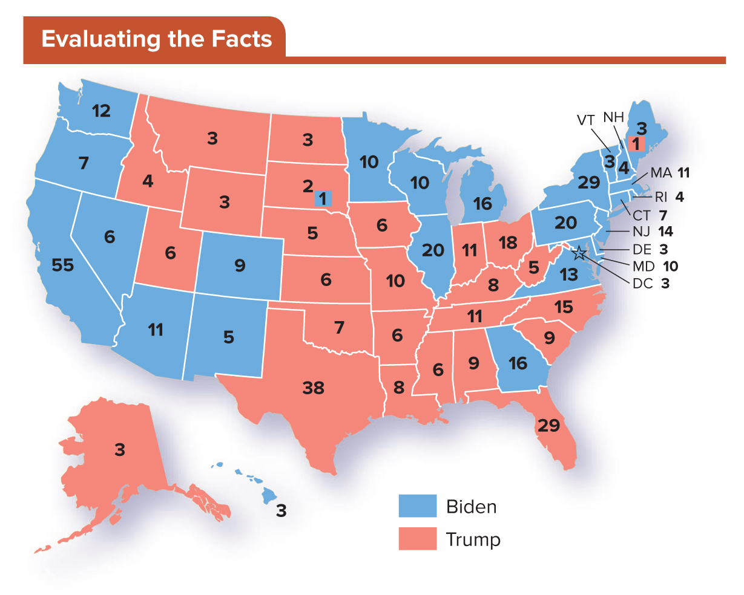
Figure 9.2 The 2020 Electoral College Vote
In what areas of the country did Donald Trump get much of his support? Where did Joe Biden win? Which candidate won the most populous states?
Access the text alternative for slide images.

Slide 29
Who Votes? Factors in Voter Participation
Not all people are equally likely to participate in the voting process to select government officials.
Voting predictors:
Education level—the number one predictor.
Age.
Race and ethnicity.
Income.
Party competitiveness and voter turnout.

Slide 30
Education Level—the Number One Predictor of Voting
Individual’s level of education is the best predictor of whether that person will vote.
Typically, as education increases, so too does the likelihood of voting, with measurable differences even between those who have only attended college and those who have graduated.

Slide 31
The Age Factor
Young adults are less likely to vote than Americans who are middle-aged and older, although the figure has increased in recent years.
In both 2008 and 2012, the youth vote was a key deciding factor.
Why don’t young voters typically turn out?

Slide 32
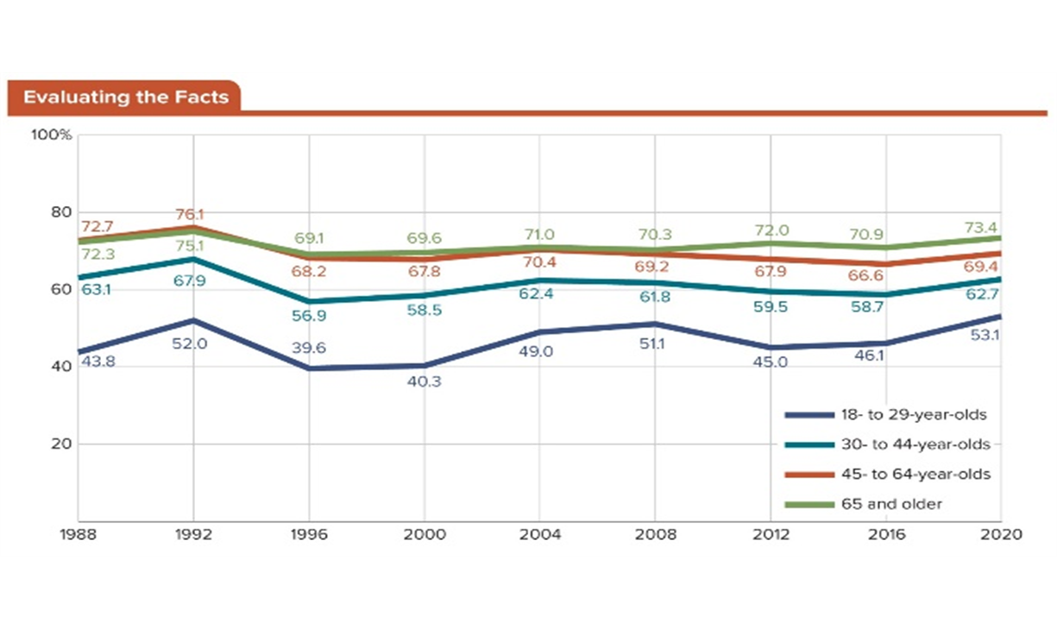
Figure 9.3 Age and Voting in Presidential Elections
The percentage of people in various age groups who voted in the 2012 presidential election illustrates a historic trend: As Americans age, they are more likely to vote.
Access the text alternative for slide images.
SOURCE: United States Census Bureau.

Slide 33
Race, Ethnicity, and Voter Participation
In 2016 and 2020, race and ethnicity became pivotal.
Trump increased the probability with his initial refusal to disavow white supremacist supporters and with his pejorative characterization of Mexican immigrants.
Turnout by African Americans remained high, though not at the record-setting pace generated by the Obama campaigns.
Participation by Latinx also declined; but they are viewed as an important constituency because they are an expanding proportion of the population.

Slide 34
Income—A Reliable Predictor of Voting
Besides education, income is one of the best predictors of whether an American will vote.
Typically, in recent presidential election years, U.S. citizens with the lowest income level have had voter turnout levels of 50 to 60 percent, whereas those with the highest income level have had turnout levels above 85 percent.
As income increases, so does the likelihood of voting.

Slide 35
Party Competitiveness and Voter Turnout
Close races usually bring a higher voter turnout.
Voter efficacy is higher: one vote could make the difference.
Close races usually bring more media attention.
Turnout rate: the proportion of eligible voters who actually voted.

Slide 36
How Voters Decide
Some voters evaluate candidates on the basis of their positions on issues and then cast their ballots for those who best represent their views.
Called prospective voting, this method of candidate evaluation focuses on what the candidates will do in the future.
More common form of candidate evaluation is retrospective voting, in which a voter evaluates an incumbent candidate on the basis of whether the incumbent’s past decisions and actions are satisfactory to the voter.

Slide 37
Major Factors in Voter Decision Making
First and foremost, an issue must be salient to voters—that is, it must resonate with them and reflect something that they care deeply about.
Incumbency—already holding the office—is a “known commodity” and thus more likely to receive a voter’s support.

Slide 38
Campaign Influences on Voter Choice
Modern campaign trends include a far deeper reliance on paid professional staffers and the prevalence of social media and the traditional media as tools for communicating with voters.
Voter choices are also affected by increasingly negative campaigns.
Research shows that negative campaigning can suppress voter turnout in several ways.

Slide 39
Why Some People Do Not Vote
Negative campaigning is one reason why some people do not vote, but there are several others.
Lack of efficacy.
Voter fatigue and negative campaigns.
Structure of elections.
Rational choice theory.

Slide 40
Lack of Efficacy
Many people do not believe that the government listens to people like them or that their vote actually matters.
Poorer people are more likely than better-off individuals to feel that the government does not listen to people like them.

Slide 41
Voter Fatigue and Negative Campaigns
In the United States, campaigns tend to be long-drawn-out affairs.
Some scholars say that the lengthiness of the campaigns leads to voter fatigue.
Prevalence of negative campaigning compounds the phenomenon.

Slide 42
The Structure of Elections
For years, voting rights activists claimed that the registration requirements in many states were too complicated.
National Voter Registration Act of 1993 allows people to register when interacting with many government agencies, including when they apply for a driver’s license.
Overly frequent elections discourage participation.
Timing of elections also affects voter participation.

Slide 43
Rational Choice Theory
Rational choice theory asserts that some individuals decide that the “costs” of voting are not worth the effort when compared with the expected “benefits,” or what the voters could derive from voting.
Costs: the time, energy, and inconvenience required to register to vote, to become informed about candidates and elections, and to actually vote
When the costs associated with voting increase too much, turnout drops.

Slide 44
The Consequences of Nonvoting
Nonvoting is both a symptom and a result of a lack of civic involvement on the part of individuals.
When relatively few people vote in a given election, the outcome is likely to represent the will of only that subset of the electorate who voted.
There is a great deal of debate about nonvoting’s cause and effect.
Some assert that democracies with low voter turnout are more likely to generate threats to their own well-being.
Others claim that low voting rates mean that the people are satisfied with the status quo.

Slide 45
Money and Politics
Money is essential in electoral races today.
Federal regulations require any group that provides campaign contributions to a candidate register as a political action committee (PAC).
PACs are subject to contributions limits.
Citizens United v. Federal Election Commission (2010) allowed for super PACs.
Can raise and spend unrestricted amounts of money.
Contributions must be used independently of any candidate or official campaign.

Slide 46
Early Efforts to Regulate Campaign Finance 1
Federal Corrupt Practices Act of 1925.
Hatch Act of 1939.
Banned partisan political activities by all federal government employees.
Exceptions for the president, the vice president, and Senate-confirmed political appointees.
Federal Election Campaign Act (FECA) of 1971.
Considerable limitations placed on campaign contributions and expenditures.

Slide 47
Early Efforts to Regulate Campaign Finance 2
In 1974, FECA was amended.
More stringent limitations on individual contribution.
Limit on expenditures by PACs.
Revamped the presidential election process by restricting spending and providing public financing option.
Required public disclosure of contributions and expenditures by all candidates for federal office.
Most importantly, the act created an enforcement mechanism in the Federal Election Commission (FEC).

Slide 48
The Court Weighs In: Money = Speech
In Buckley v. Valeo (1976), the Supreme Court ruled that an individual could spend as much of their wealth they wished on their own campaign.
Ruling paved the way for the subsequent explosion in the formation of PACs.
Recognized political expenditures as protected speech.
Ballooning of the number of PACs over time is indicative of the increased power that PACs have wielded in campaigns for federal office since 1980.

Slide 49
The Bipartisan Campaign Finance Reform Act of 2002
McCain-Feingold Act, formally known as the Bipartisan Campaign Finance Reform Act (BCRA) of 2002, banned nearly all soft money contributions.
McConnell v. the Federal Election Commission (2003) upheld the BCRA.
Federal Election Commission v. Wisconsin Right to Life, Inc. (2007) overturned the BCRA.

Slide 50
The Court Weighs In (Again): The Birth of Super PACs
In Citizens United v. FEC (2010) the Supreme Court ruled that corporations and labor unions are entitled to the same free speech rights that individuals enjoy.

Slide 51
Super PACs and Independent Expenditures
Because expenditures are protected from limitations, many PACs now use independent expenditures to spend unlimited sums for or against political candidates.
Independent expenditures are outlays, typically for advertisements supporting or opposing a candidate, that are uncoordinated with a candidate’s campaign.
Citizens United had an impact in the 2020 presidential campaign.
During the primary season alone, more than 2,400 super PACs had organized and raised and spent more than $1 billion.

Slide 52
Table 9.1 Contribution Limitations by Donor and Campaign Recipients Under the Bipartisan Campaign Finance Reform Act, 2020 Cycle
AMOUNT DONORS MAY GIVE | CANDIDATE OR CANDIDATE COMMITTEE PER ELECTION | NATIONAL PARTY COMMITTEE PER CALENDAR YEAR | STATE, DISTRICT, AND LOCAL PARTY COMMITTEE PER CALENDAR YEAR | ANY OTHER POLITICAL ACTION COMMITTEE PER CALENDAR YEAR | ADDITIONAL NATIONAL PARTY COMMITTEE ACCOUNTS
INDIVIDUAL | $2,800 | $35,500 | $10,000 (combined limit) | $5,000 | $106,500 per account
NATIONAL PARTY COMMITTEE | $5,000 | No limit | No limit | $5,000 | No limit
STATE, DISTRICT, AND LOCAL PARTY COMMITTEE | $5,000 (combined limit) | No limit | No limit | $5,000 (combined limit) | No limit
PAC (MULTI CANDIDATE) | $5,000 | $15,000 | $5,000 (combined limit) | $5,000 | $45,000 per account
PAC (NOT MULTI CANDIDATE) | $2,800 | $35,500 | $10,000 (combined limit) | $5,000 | $106,500 per account
CANDIDATE COMMITTEE | $2,000 | No limit | No limit | $5,000 | No limit
Table divided into 6 columns summarizes contribution limitations by donor and campaign recipients under the Bipartisan Campaign Finance Reform Act, 2020 Cycle. The column headers are marked from left to right as: Amount donors may give, candidate or candidate committee per election, national party committee per calendar year, recipients, any other political action committee per calendar year, and additional national party committee accounts. Column 4, recipients is followed by a sub-column which is marked as state, district, and local party committee per calendar year.
SOURCE: Federal Election Commission, “Contribution Limits for 2019–2020.”

Slide 53
Circumventing the Rules: Dark Money, 527s, and 501(c)4s 1
Loopholes in the campaign-finance law became apparent with the emergence of new forms of political groups, so-called 527s and 501(c)4s.
Named after the sections of the Internal Revenue Service tax code that regulate such organizations.
501(c)4s are nonprofit organizations exclusively operated for the promotion of social welfare, including lobbying or engaging in political campaigning.
Go largely unregulated by the Federal Election Commission, and their activities are not subject to the transparency requirements that regulated entities are.

Slide 54
Circumventing the Rules: Dark Money, 527s, and 501(c)4s 2
527 is a tax-exempt group that raises money for political activities, much like those allowed under the soft money loophole.
Disclosure is required only if the group engages in activities expressly advocating for the election or defeat of a federal candidate or if it participates in electioneering communications.

Slide 55
Review 1
Then—Political party-dominated campaigns and grassroots activism were deciding factors in how people voted.
Now—Candidate-centered campaigns rely on a mix of free social media to communicate with voters, paid professionals, and costly media buys to refine their messages to voters.

Slide 56
Review 2
Next:
How will new technologies drive how people vote and how campaigns are run?
How can government, candidates, and voters protect the electoral system from voter suppression, fraud, and corruption?
How will changes in the campaign finance system, including the advent of super PACs, affect how campaigns are waged?

Slide 57
End of Main Content
Copyright 2022 © McGraw Hill LLC. All rights reserved. No reproduction or distribution without the prior written consent of McGraw Hill LLC.

Slide 58
Accessibility Content: Text Alternatives for Images

Slide 59
Figure 9.1 Office Group and Party Column Ballots - Text Alternative
Return to parent-slide containing images.
Office-group call-outs read: 'Voters mark an X in the square to select their candidate, 'note grouping by office', and 'candidates listed in random order'.
Party-column ballot call-outs read: 'Each column shows party symbol', 'voters mark an X in the circle to select all party candidates', and 'voters mark an X in the square to select candidates from different parties'.
Return to parent-slide containing images.

Slide 60
Figure 9.2 The 2020 Electoral College Vote - Text Alternative
Return to parent-slide containing images.
Map showing the states "won" (Electoral College votes) by presidential candidates Hillary Clinton and Donald Trump in the 2016 presidential election. President Trump won 290 Electoral College votes, shown in the map as the "red" states. Hillary Clinton won 228 Electoral College votes, shown in the map as the "blue" states. The majority of states "won" by Hillary Clinton were on the West Coast and North Eastern United States, while Donald Trump won the majority of states in the Midwest, South and Great Lakes region.
Return to parent-slide containing images.

Slide 61
Figure 9.3 Age and Voting in Presidential Elections - Text Alternative
Return to parent-slide containing images.
Graph shows voter participation by age group in the presidential election since 1988. Lowest voter turnout has been amongst Americans between eighteen and twenty-nine years, at a low of 39.6% in 1996 and highs in 1992 (52%) and 2008 (51.1%). Americans between thirty and forty-four years had the highest voter turnout in 1992 with 67.9%, dropping to 56.9% afterwards and offering within 2% of the 60% mark since then. Voter turnout amongst Americans between forty-five and sixty-four and those over sixty-five has been closely aligned between 1988 in 2008, ranging between 76% (1992) and 70% (2008). Since then, voter turnout amongst 45 to 64-year-old has dropped slightly to 66.6% in 2016 compared to 71% amongst those over sixty-five.
Return to parent-slide containing images.

